Slide 1
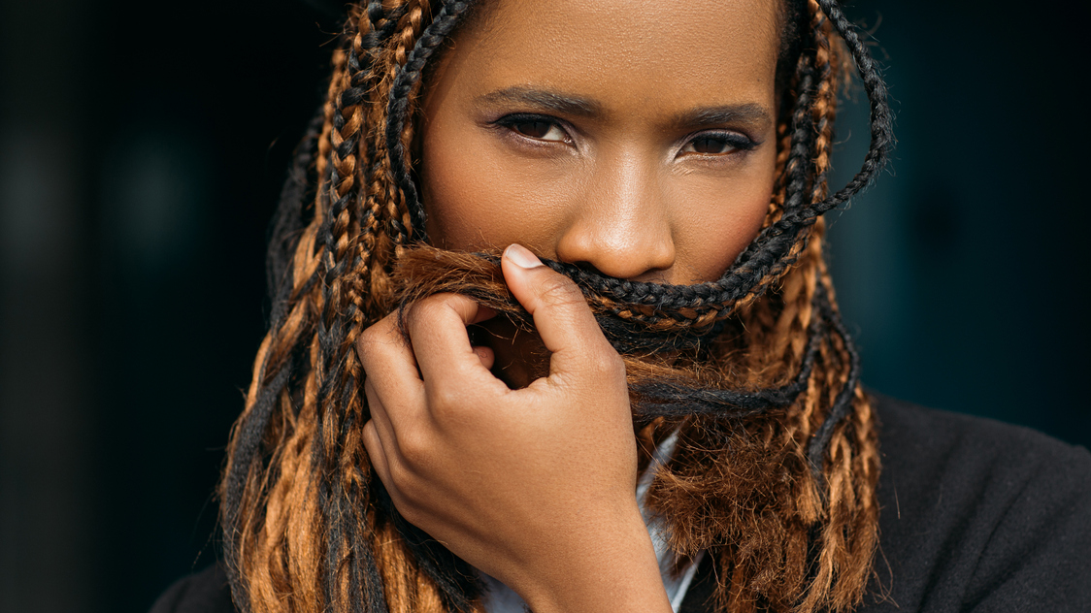




Understanding young low income women in South Africa: Behavioural, sociological and product market opportunities and challenges
Project Sasha Fierce
Quantitative Presentation
February 2018

Slide 2
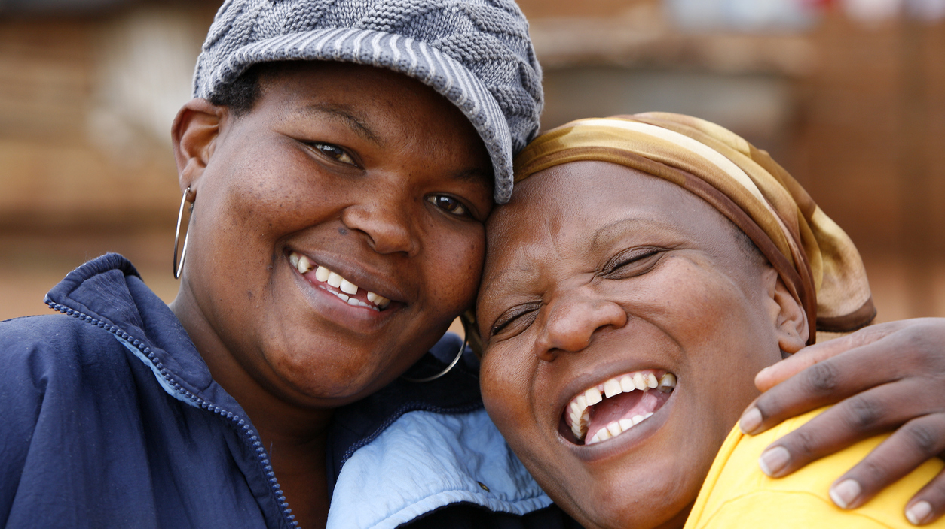
1
Background and Objectives

Slide 3
Your business issues
Social factors such as rape, poor economic conditions and the inability to insist on condom usage, make South African women vulnerable to HIV infection.
Historically, campaigns positioning products for disease prevention have not taken into account the reality of the daily lives of these women and the difficulties they face gaining control over their own sexual lives. They have hence not proved to be effective in uptake and adherence of these products.
NIAID’s have identified young, low income women in South Africa as a key target group with a key interest in understanding how they shop for personal care products and make purchase decisions.
A holistic understanding of the lifestyles, beliefs, product choices and influencers of this target group will unlock product marketing opportunities in order to drive uptake and adherence of STD preventative products in the future.

Slide 4
Understanding your business issues
Unlocking product marketing opportunities that meet the needs of young, low income women in South Africa in order to drive uptake and adherence of sexual disease preventative products going forward
1. How do we describe young, low income women in South Africa?
3. What are their attitudes, beliefs and behaviours towards life in general and their sexual health?
2. How does the market make product purchase decisions? Which are the most influential touchpoints along the P2P?
4. What is the level of digital and social media engagement in this connected world?
What are consumer profiles?
What are their living circumstances?
What are their socio-economic influencers?
What are consumers life goals and aspirations?
What are their challenges, anxieties and hardships?
What entertainment activities do they engage in?
How do we frame psychological and socioeconomic characteristics to segment groups and personalise offerings?
How planned is the category?
What are the resulting shopper journeys for personal care products?
What are the characteristics of each journey (drivers, barriers, importance, retailer choice etc.)
What’s the effectiveness, reach and impact of touchpoints along the P2P?
What is the usage of digital products?
What is the usage of social platforms and what is the level of social influence?

Slide 5
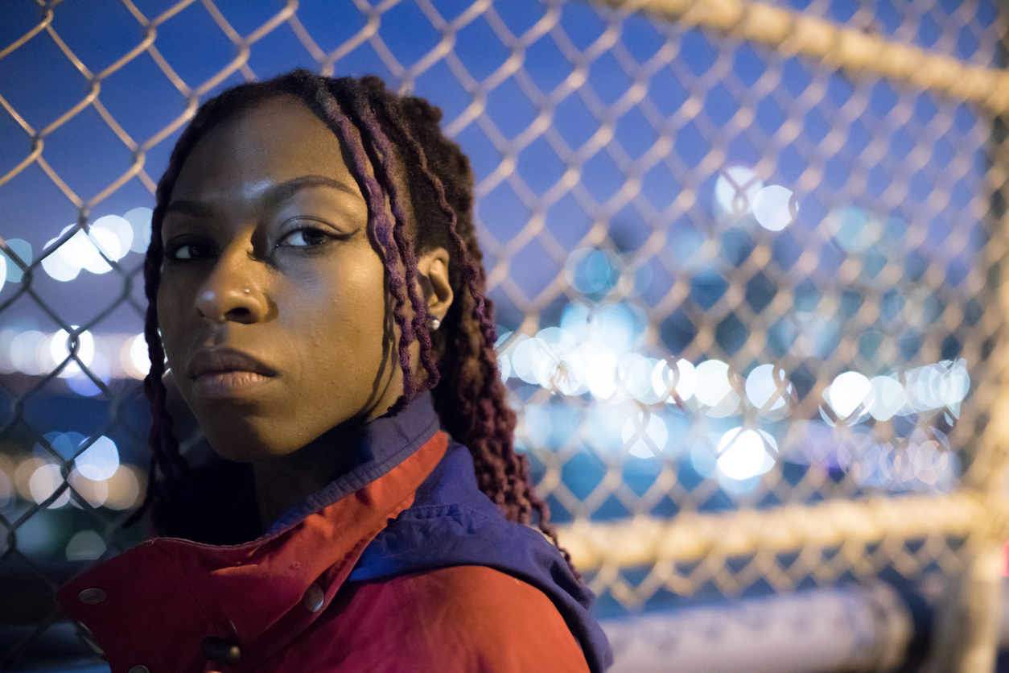
2
Research Approach

Slide 6

Quantitative research methodology
A robust sample size of n=1500 allowed for precise sizing of opportunities, segmentation and market profiling. The sample is representative of young black women aged 14 to 25 living in urban and small-urban areas and with an LSM level of 4 to 7 (lower income socio economic group).
What?
Who?
Where?
Sampling?
How?
Robust quantitative study n=1500
Young females, aged 14 to 25 in LSM 4 to 7
The data is weighted by LSM and region
National - metro and small-urban
Random suburb sampling with area and age quotas
Face-to-face Computer Aided Personal Interviews
40 minute interview duration

Slide 7
Quantitative segmentation approach
Preparing the data: Cleaning and editing of data, deriving new variables and combining variables
Decision on most useful segmentation solution based on analysis of each solution
Segmentation using Two Step Cluster Analysis
01
03
05
02
04
Selection of variables to use for segmentation
Profiling and analysis of segments

Slide 8
Overview of the market
Black Females
LSM (%)
Urban area (%)
Quota applied
Quota applied
53
53
n= 1500

Slide 9
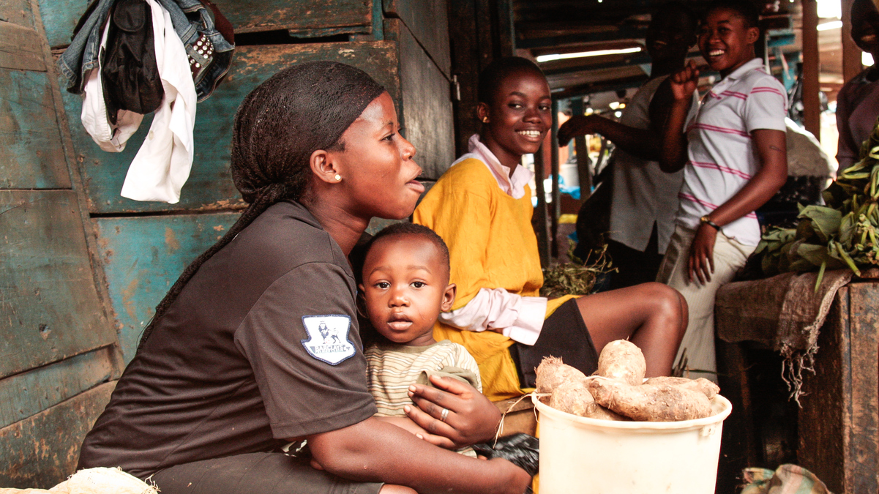
3
Setting the scene

Slide 10
Sexually active market
Total market
100%
44%
Ever had sex
36%
Sexually active in p3m
7%
7%
Multiple sexual partners in p12m
n= 1500

Slide 11
HIV vulnerability/ risk definition
The risk score is based on:
Sexually active
Abstinence
Number of partners
Condom use
Type of partner (casual or not)
Lower risk
Higher risk
1. Not yet sexually active and intentionally abstains from having sex
Not yet sexually active but does not intend to abstain
Sexually active and uses a condom but has just one partner or avoids casual sex
Sexually active with multiple partners
Sexually active with a single partner but does not use a condom or does not actively avoid casual sex

Slide 12
Derived level of vulnerability/ risk of HIV in the market 7 in 10 of the market is at risk to HIV infection
Level of HIV vulnerability/ risk

Slide 13
What is the level of sexual behaviour across age groups?

Slide 14
What steps are the market actively taking to protect themselves from contracting HIV?
Steps actively taken to protect from HIV (%)
n= 1500

Slide 15
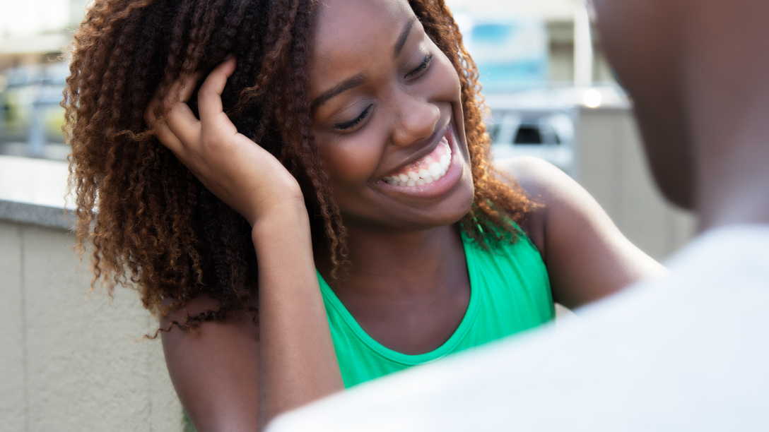
4
Understanding the markets distinct beliefs, attitudes and lifestyles towards sexual health
- An introduction to consumer segments

Slide 16
The research uncovered six differentiated young women psychographic consumer segments
Responsible Mother
The Good Girl
Protection Savvy
Conservative Survivalist
Gender Prisoner
Liberated Survivalist

Slide 17
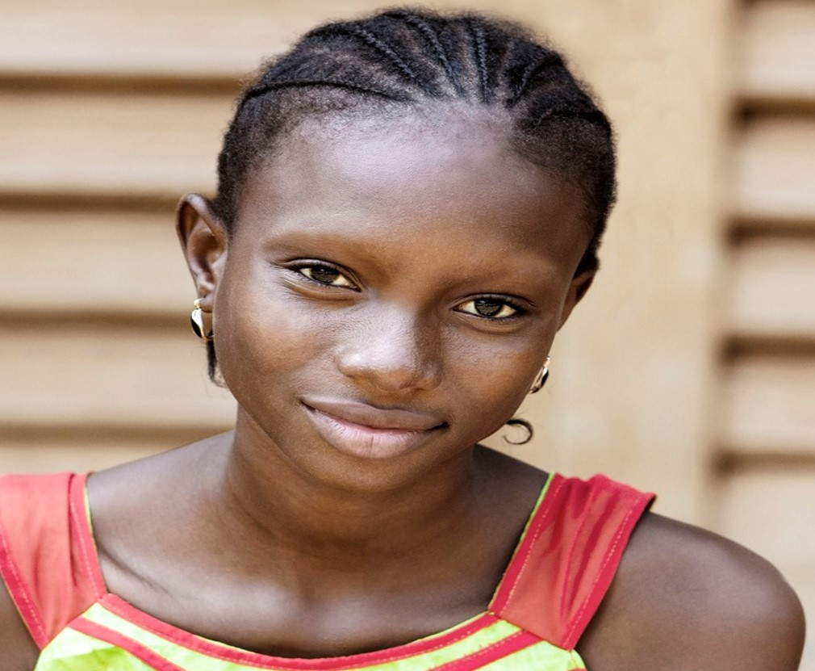


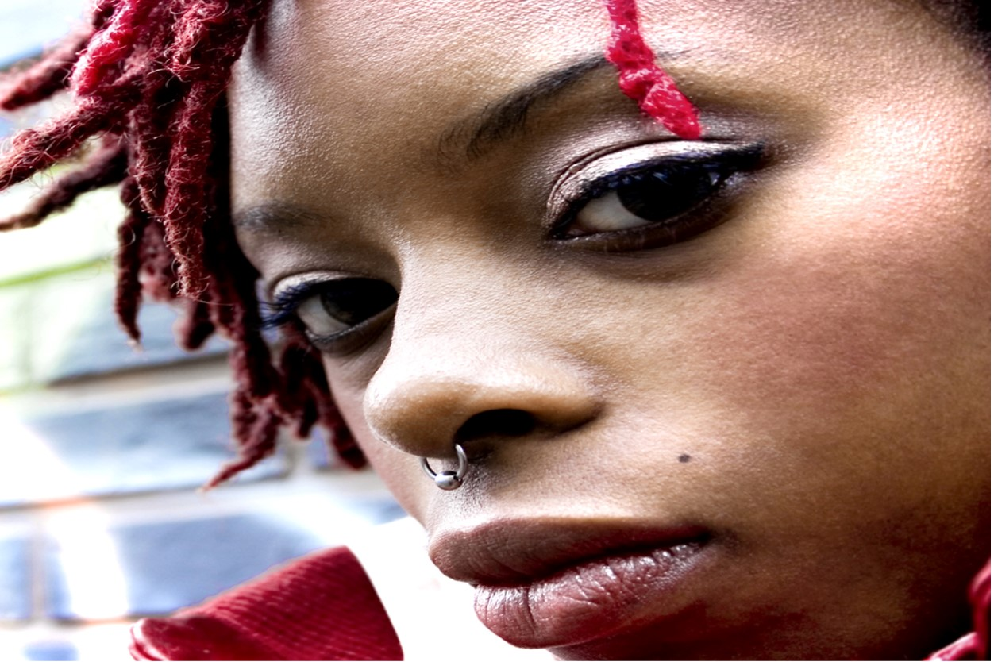

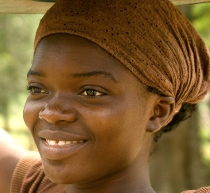
Overview of consumer segments
Constrained mom
The Good Girl (n=317)
Conservative Survivalist (n=283)
Liberated Survivalist (n=307)
Gender Prisoner (n=136)
Protection Savvy (n=191)
Responsible
Mom (n=266)
21%
17%
21%
8%
12%
20%
Young and inexperienced. Least likely to have a boyfriend or to have had sex and most likely to be in school. Comes from a stable family who are very protective and hence has little exposure to toxic influences. Enjoys being at home, watching TV, reading books or doing puzzles. Main focus is to complete her education.
These women are young adults, most likely to be living in urban areas, relatively poor and in university or looking for work. Even though they like to keep up with the latest fashions, they broach life more conservatively both in dress and their everyday endeavors. 1 in 4 are sexually active and relatively less vulnerable to HIV.
Reasonably young but out of school and living in the poorest household. These women are idealistic and free spirited – supportive of women's rights and strive to work hard to support their family and lead a better life.
They are also most likely to have one night stands and multiple partners and have little intention to prevent themselves from HIV.
This girl is in her early twenties and enjoys a party. She has a number of regular sexual partners and is most likely to be involved in transactional sex. She does not use condoms - her partners disapprove of condom use and she lacks empowerment. She uses home remedies as HIV protection and is most likely to feel at high risk of HIV. Lives in an unstable household with little parental involvement
These women are slightly older and seeking work. They are financially constrained and likely to have their own children and live with their extended family. They are determined to work hard to support their family but also still want to enjoy the freedom to socialize with friends at nightclubs or taverns.
These women are oldest, fairly better off financially and most likely to have their own children and be married/ have a partner (although small). Their main ambition is to get a good job and earn their own money in order to support their families. They are empowered and their attitudes and social norms are highly supportive of condoms and safe sex

Slide 18
Overview of segments – level of risk
The Good Girl (n=317)
Conservative Survivalist (n=283)
Liberated Survivalist (n=307)
Gender Prisoner (n=136)
Protection Savvy (n=191)
Responsible
Mom (n=266)
21%
17%
21%
8%
12%
20%
% Ever had sex
At risk:
2%
At risk:
24%
At risk:
31%
At risk:
43%
At risk:
54%
At risk:
40%
% Derived HIV risk*

Slide 19
What is the level of sexual behaviour across consumer groups?

Slide 20
Which segments are most vulnerable to contracting HIV? Responsible Moms, followed by Protection Savvy’s are cause for concern as they are least in touch with reality regarding their exposure to contacting HIV . While Gender Prisoners are the second most ‘at risk’ group, they are more in tune to their vulnerability in the market.
Perceived vulnerability/ risk
Derived actual vulnerability/ risk
Level of HIV vulnerability/ risk denial index
Total market
The Good Girl
Conservative Survivalists
Liberated Survivalists
Gender Prisoner
Protection Savvy
Responsible Moms
In touch with reality
In denial
n= 1500

Slide 21
HIV vulnerability/ risk category by segment
The Good Girl is the segment at lowest risk among both sexually active and inactive girls, followed by Conservative Survivalists. Gender Prisoners are the most at risk group.
The Good Girl | Conservative Survivalist | Liberated Survivalist | Gender Prisoner | Protection Savvy | Responsible Mom

Slide 22
Axis dynamics based on level of HIV risk and household stability
PRIVILEGED
Responsible Mother
The Good
Girl
LOW RISK
Protection
Savvy
HIGH RISK
Conservative Survivalist
Gender
Prisoner
Liberated Survivalist
SURVIVAL

Slide 23
Most important decision recently made (%)
What lifestyle changes has the market made recently?
Majority of the market are looking to improve their economic position.
Total
n= 1500
The Good Girl | 44 | 5 | 10 | 5 | 6 | 4 | 1
Conservative Survivalists | 31 | 15 | 16 | 6 | 10 | 3 | 2
Liberated Survivalists | 16 | 12 | 10 | 7 | 7 | 5 | 4
Gender Prisoners | 9 | 11 | 15 | 4 | 4 | 6 | 5
Protection Savvy | 12 | 23 | 10 | 3 | 2 | 8 | 8
Responsible mom | 26 | 20 | 14 | 7 | 2 | 5 | 9
Significantly higher than total market

Slide 24
Key indicators – attitudes, lifestyles, beliefs
 | The Good Girl – 21% | Conservative Survivalist – 17% | Liberated Survivalist – 21% | Gender Prisoner – 8% | Protection Savvy – 12% | Responsible Mom – 20%
Attitudes, lifestyles, beliefs | Abstains from sex Protective family, Prefers to be at home | Protective family Hard working Keeps up with latest fashion Clothing part of identity Conservative dress | Hard working Puts family first Stands up for women's rights Trust is key when selecting a partner | One night stands Low self esteem Partner dictates protection to use Home remedies as HIV protection Blesser | Hard working Puts family first Stands up for women's rights Sexually active Allowed a boyfriend | Confides in partner about sex and HIV Trusting relationship Insists on using a condom
Entertainment Activities | TV, books, crosswords, religious gatherings | Baking, TV, music | Tavern/ shebeen | Tavern/ shebeen, gambling, traditional gathering, braai, picnic | Cooking, tavern/ shebeen, nightclub | Music, cooking, TV, books
Sexually active | 10% | 37% | 39% | 51% | 71% | 71%
Derived High HIV risk | 2% | 24% | 31% | 43% | 54% | 40%
Sexual partners > 1 | 4% | 10% | 34% | 21% | 21% | 9%
STD Prevention | Abstinence | Avoids casual sex | Do nothing | Do nothing, reduce frequency of sex | Use condoms | Use condoms, one partner, faithful
Recent lifestyle change | Complete education | Complete education, look after health, stand up for my rights | Find a boyfriend/ husband, stop having one night stands | Find a boyfriend/ husband, stop having one night stands | Find a job, have safe sex, check HIV status | Look after health, find a job, save more money

Slide 25
Key indicators – demographics
 | The Good Girl – 21% | Conservative Survivalist – 17% | Liberated Survivalist – 21% | Gender Prisoner – 8% | Protection Savvy – 12% | Responsible Mom – 20%
Age | 14 – 17 years | 18 – 21 years | 14-25 years | 20-25 years | 22 - 25 years | 22 - 25 years
Education | In school | Out of school/ in university | Out of school | Out of school | Out of school | Completed school
Work status | Scholar | Student/seeking working | Student/seeking working | Student/seeking working | Working or seeking work | Working or seeking work
Average HH income | R7200 | R5615 | R4915 | R8005 | R6555 | R8880
Household structure | Stable (<5) | Large (6+) | Smaller (<4) | Large (6+) | Large (6+) | Stable (<5)
People in household | Mother, father, siblings | Mother, father, siblings | Other adults | Extended family, own children | Extended family, own children | Own children

Slide 26
Snapshot of each Consumer Segment

Slide 27
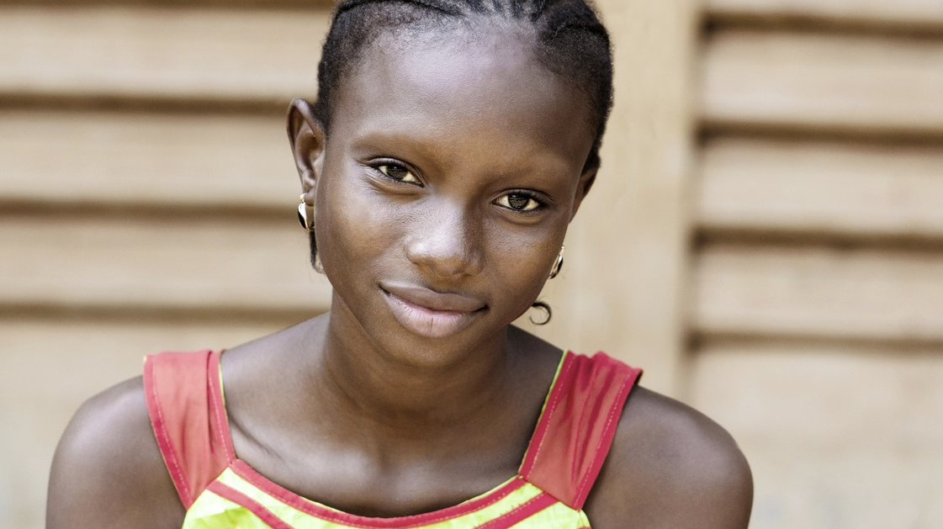
THE GOOD GIRL
SHARE OF market| 21%
At risk| 2%

Slide 28
THE GOOD GIRL - Key indicators: Situation and relationships
SHARE OF market| 21%
At risk| 2%
WHO SHE IS
HER SITUATION
Mean number of people living in household
HER HOUSEHOLD
Index
Mean age:
18
4.6
Mean Household income
R7 200
Weighted | n=116
Unweighted | n=136
Base size:

Slide 29
THE GOOD GIRL - Key indicators: Media usage habits
SHARE OF market| 21%
At risk| 2%
CONSUMERS
They’re online at least once a day | 1.14
TOUCH POINTS
No. of online activities they’ll do daily: | 4.06
No. of online activities they’ll do per week: | 6.02
CONTENT
Percentage who use social every day: | 55
Average number of platforms they use: | 2.35
Internet Access %:
Top online activities %:
Most favored social networks %:
Social media influence %:
Spends a lot of time on social media | 70
Can’t live without social media | 62
Main source of news & entertainment | 64
Expresses views on social media | 50
Trusts what people say on social media | 36
Seeks advice from social media | 31
Offline activities %:
Weighted | n=320
Unweighted | n=317
Base size:

Slide 30
THE GOOD GIRL - Key indicators: Shopping behaviours
SHARE OF market| 21%
At risk| 2%
PRE-STORE
PURCHASE
TOUCHPOINTS
Purchase decision making
Shopping Mission (%)
Responsible for own purchase decisions | 57%
Have assistance with purchase decision making | 43%
Purchases assisted by mother | 82%
Pay for own purchases | 51%
Purchase decision? (%)
Shopper journey mindset (%)
Routine
Key drivers for choosing a product
Pressured
Better quality brand than others
It is my usual brand
Easy to use
Offers the most comfort to skin
Exploration
Weighted | n=320
Unweighted | n=317
Base size:

Slide 31

Conservative Survivalist
SHARE OF market| 17%
At risk| 24%

Slide 32
Conservative Survivalist - Key indicators: Situation and relationships
SHARE OF market| 17%
At risk| 24%
Mean number of people living in household
WHO SHE IS
HER SITUATION
HER HOUSEHOLD STRUCTURE
Mean age:
20
5
Mean Household income
R5,615

Slide 33
Conservative Survivalist - Key indicators: Media usage habits
SHARE OF market| 17%
At risk| 24%
CONSUMERS
They’re online at least once a day | 1.24
TOUCH POINTS
No. of online activities they’ll do daily: | 4.13
No. of online activities they’ll do per week: | 6.57
CONTENT
Percentage who use social every day: | 63
Average number of platforms they use: | 2.25
Internet Access %:
Top online activities %:
Most favored social networks %:
Social media influence %:
Spends a lot of time on social media | 70
Can’t live without social media | 66
Main source of news & entertainment | 71
Expresses views on social media | 55
Trusts what people say on social media | 44
Seeks advice from social media | 44
Offline activities %:
Weighted | n=259
Unweighted | n=283
Base size:

Slide 34
Conservative Survivalist - Key indicators: Shopping behaviours
SHARE OF market| 17%
At risk| 24%
PRE-STORE
PURCHASE
TOUCHPOINTS
Purchase decision making
Shopping Mission (%)
Responsible for own purchase decisions | 76%
Have assistance with purchase decision making | 24%
Purchases assisted by mother | 84%
Pay for own purchases | 66%
Purchase decision? (%)
Shopper journey mindset (%)
Routine
Key drivers for choosing a product
Pressured
It is my usual brand
Easy to use
Better quality brand than others
It is a trustworthy brand
Exploration
Weighted | n=259
Unweighted | n=283
Base size:

Slide 35

Liberated Survivalist
SHARE OF market| 21%
At risk| 31%

Slide 36
Liberated Survivalist - Key indicators: Situation and relationships
SHARE OF market| 21%
At risk| 31%
Mean number of people living in household
WHO SHE IS
HER SITUATION
HER HOUSEHOLD STRUCTURE
Mean age:
20
4.4
Mean Household income
R4,915

Slide 37
Liberated Survivalist - Key indicators: Media usage habits
SHARE OF market| 21%
At risk| 31%
CONSUMERS
They’re online at least once a day | 1
TOUCH POINTS
No. of online activities they’ll do daily: | 4.23
No. of online activities they’ll do per week: | 7.36
CONTENT
Percentage who use social every day: | 56
Average number of platforms they use: | 2.35
Internet Access %:
Top online activities %:
Most favored social networks %:
Social media influence %:
Spends a lot of time on social media | 61
Can’t live without social media | 52
Main source of news & entertainment | 54
Expresses views on social media | 53
Trusts what people say on social media | 52
Seeks advice from social media | 59
Offline activities %:
Weighted | n=317
Unweighted | n=307
Base size:

Slide 38
Liberated Survivalist - Key indicators: Shopping behaviours
SHARE OF market| 21%
At risk| 31%
PRE-STORE
PURCHASE
TOUCHPOINTS
Purchase decision making
Shopping Mission (%)
Responsible for own purchase decisions | 78%
Have assistance with purchase decision making | 22%
Purchases assisted by mother | 84%
Pay for own purchases | 79%
Purchase decision? (%)
Shopper journey mindset (%)
Routine
Key drivers for choosing a product
Pressured
Better quality brand than others
Easy to use
It is my usual brand
It is a trustworthy brand
Exploration
Weighted | n=317
Unweighted | n=307
Base size:

Slide 39
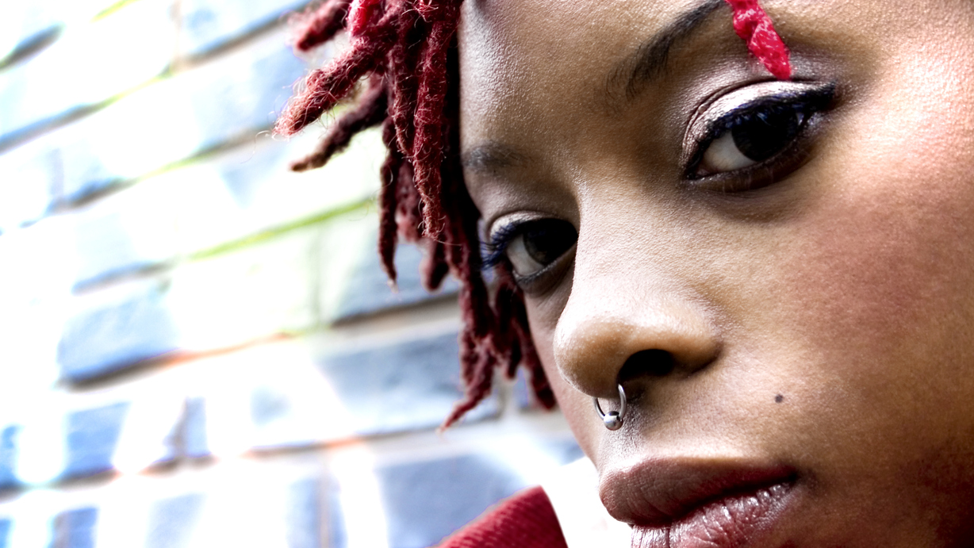
GENDER PRISONER
SHARE OF market| 8%
At risk| 43%

Slide 40
Gender Prisoner - Key indicators: Situation and relationships
SHARE OF market| 8%
At risk| 43%
Mean number of people living in household
WHO SHE IS
HER SITUATION
HER HOUSEHOLD STRUCTURE
Mean age:
21
4.7
Mean Household income
R8,005
Weighted | n=116
Unweighted | n=136
Base size:

Slide 41
Gender Prisoner - Key indicators: Media usage habits
SHARE OF market| 8%
At risk| 43%
CONSUMERS
They’re online at least once a day | 1.02
TOUCH POINTS
No. of online activities they’ll do daily: | 5.73
No. of online activities they’ll do per week: | 8.75
CONTENT
Percentage who use social every day: | 56
Average number of platforms they use: | 2.37
Internet Access %:
Top online activities %:
Most favored social networks %:
Social media influence %:
Spends a lot of time on social media | 63
Can’t live without social media | 66
Main source of news & entertainment | 74
Expresses views on social media | 64
Trusts what people say on social media | 71
Seeks advice from social media | 65
Offline activities %:
Weighted | n=116
Unweighted | n=136
Base size:

Slide 42
Gender Prisoner - Key indicators: Shopping behaviours
SHARE OF market| 8%
At risk| 43%
PRE-STORE
PURCHASE
TOUCHPOINTS
Purchase decision making
Shopping Mission (%)
Responsible for own purchase decisions | 89%
Have assistance with purchase decision making | 11%
Purchases assisted by mother | 81%
Pay for own purchases | 88%
Purchase decision? (%)
Shopper journey mindset (%)
Routine
Key drivers for choosing a product
Pressured
It is my usual brand
Better quality brand than others
Easy to use
It is a trustworthy brand
Exploration
Weighted | n=116
Unweighted | n=136
Base size:

Slide 43
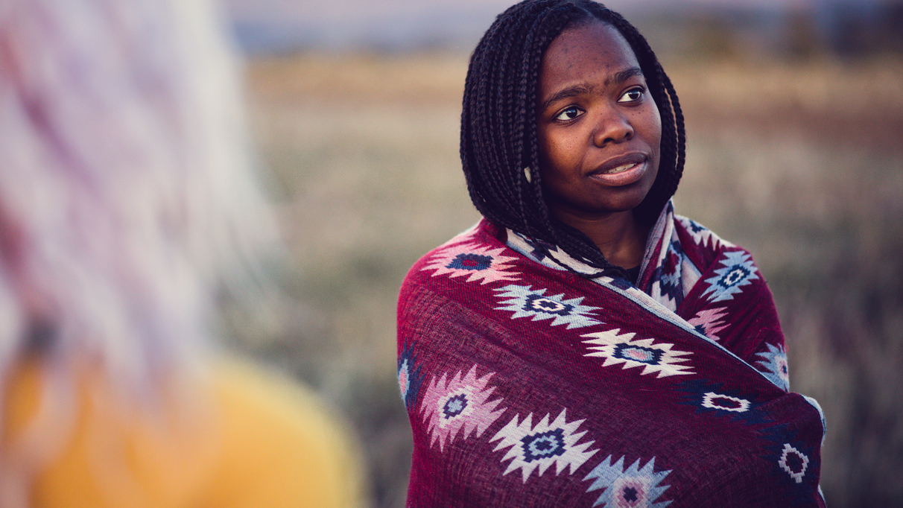
PROTECTION SAVVY
SHARE OF market| 12%
At risk| 54%

Slide 44
Protection Savvy- Key indicators: Situation and relationships
SHARE OF market| 12%
At risk| 54%
Mean number of people living in household
WHO SHE IS
HER SITUATION
HER HOUSEHOLD STRUCTURE
Mean age:
22
4.5
Mean Household income
R6,555

Slide 45
Protection Savvy - Key indicators: Media usage habits
SHARE OF market| 12%
At risk| 54%
CONSUMERS
They’re online at least once a day | 1.16
TOUCH POINTS
No. of online activities they’ll do daily: | 3.62
No. of online activities they’ll do per week: | 6.0
CONTENT
Percentage who use social every day: | 53
Average number of platforms they use: | 2.42
Internet Access %:
Top online activities %:
Most favored social networks %:
Social media influence %:
Spends a lot of time on social media | 71
Can’t live without social media | 67
Main source of news & entertainment | 67
Expresses views on social media | 60
Trusts what people say on social media | 55
Seeks advice from social media | 54
Offline activities %:
Weighted | n=183
Unweighted | n=191
Base size:

Slide 46
Protection Savvy - Key indicators: Shopping behaviours
SHARE OF market| 12%
At risk| 54%
PRE-STORE
PURCHASE
TOUCHPOINTS
Purchase decision making
Shopping Mission (%)
Responsible for own purchase decisions | 87%
Have assistance with purchase decision making | 13%
Purchases assisted by mother | 75%
Pay for own purchases | 89%
Purchase decision? (%)
Shopper journey mindset (%)
Routine
Key drivers for choosing a product
Pressured
It is my usual brand
Better quality brand than others
Easy to use
It is a trustworthy brand
Exploration
Weighted | n=183
Unweighted | n=191
Base size:

Slide 47
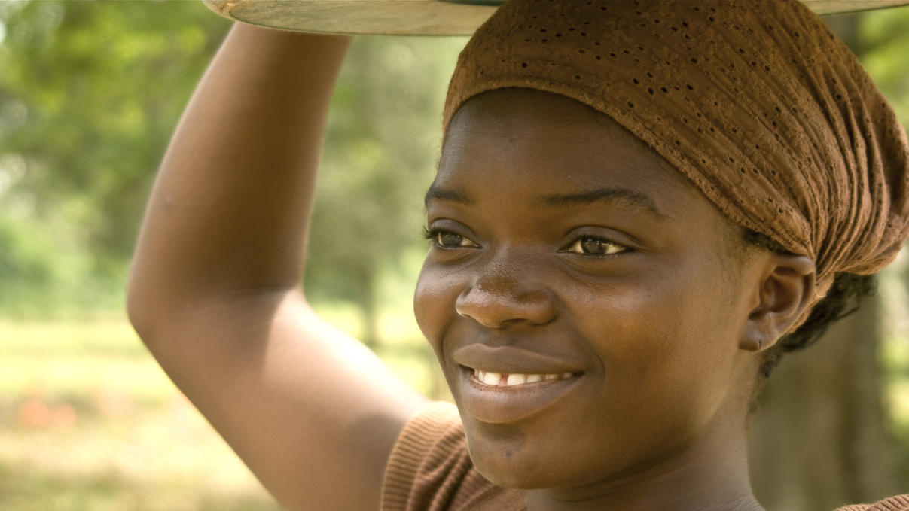
RESPONSIBLE MOM
SHARE OF market| 20%
At risk| 40%

Slide 48
Responsible MOM - Key indicators: Situation and relationships
SHARE OF market| 20%
At risk| 40%
Mean number of people living in household
WHO SHE IS
HER SITUATION
HER HOUSEHOLD STRUCTURE
Mean age:
22
4.4
Mean Household income
R8,880
Weighted | n=305
Unweighted | n=266
Base size:

Slide 49
Responsible MOM - Key indicators: Media usage habits
SHARE OF market| 20%
At risk| 40%
CONSUMERS
They’re online at least once a day | 1.44
TOUCH POINTS
No. of online activities they’ll do daily: | 3.42
No. of online activities they’ll do per week: | 5.34
CONTENT
Percentage who use social every day: | 67
Average number of platforms they use: | 2.52
Internet Access %:
Top online activities %:
Most favored social networks %:
Social media influence %:
Spends a lot of time on social media | 71
Can’t live without social media | 62
Main source of news & entertainment | 54
Expresses views on social media | 42
Trusts what people say on social media | 44
Seeks advice from social media | 39
Offline activities %:
Weighted | n=305
Unweighted | n=266
Base size:

Slide 50
Responsible Mom - Key indicators: Shopping behaviours
SHARE OF market| 20%
At risk| 40%
PRE-STORE
PURCHASE
TOUCHPOINTS
Purchase decision making
Shopping Mission (%)
Responsible for own purchase decisions | 88%
Have assistance with purchase decision making | 12%
Purchases assisted by mother | 90%
Pay for own purchases | 83%
Purchase decision? (%)
Shopper journey mindset (%)
Routine
Key drivers for choosing a product
Pressured
It is my usual brand
Better quality brand than others
Easy to use
It is a trustworthy brand
Exploration
Weighted | n=305
Unweighted | n=266
Base size:

Slide 51
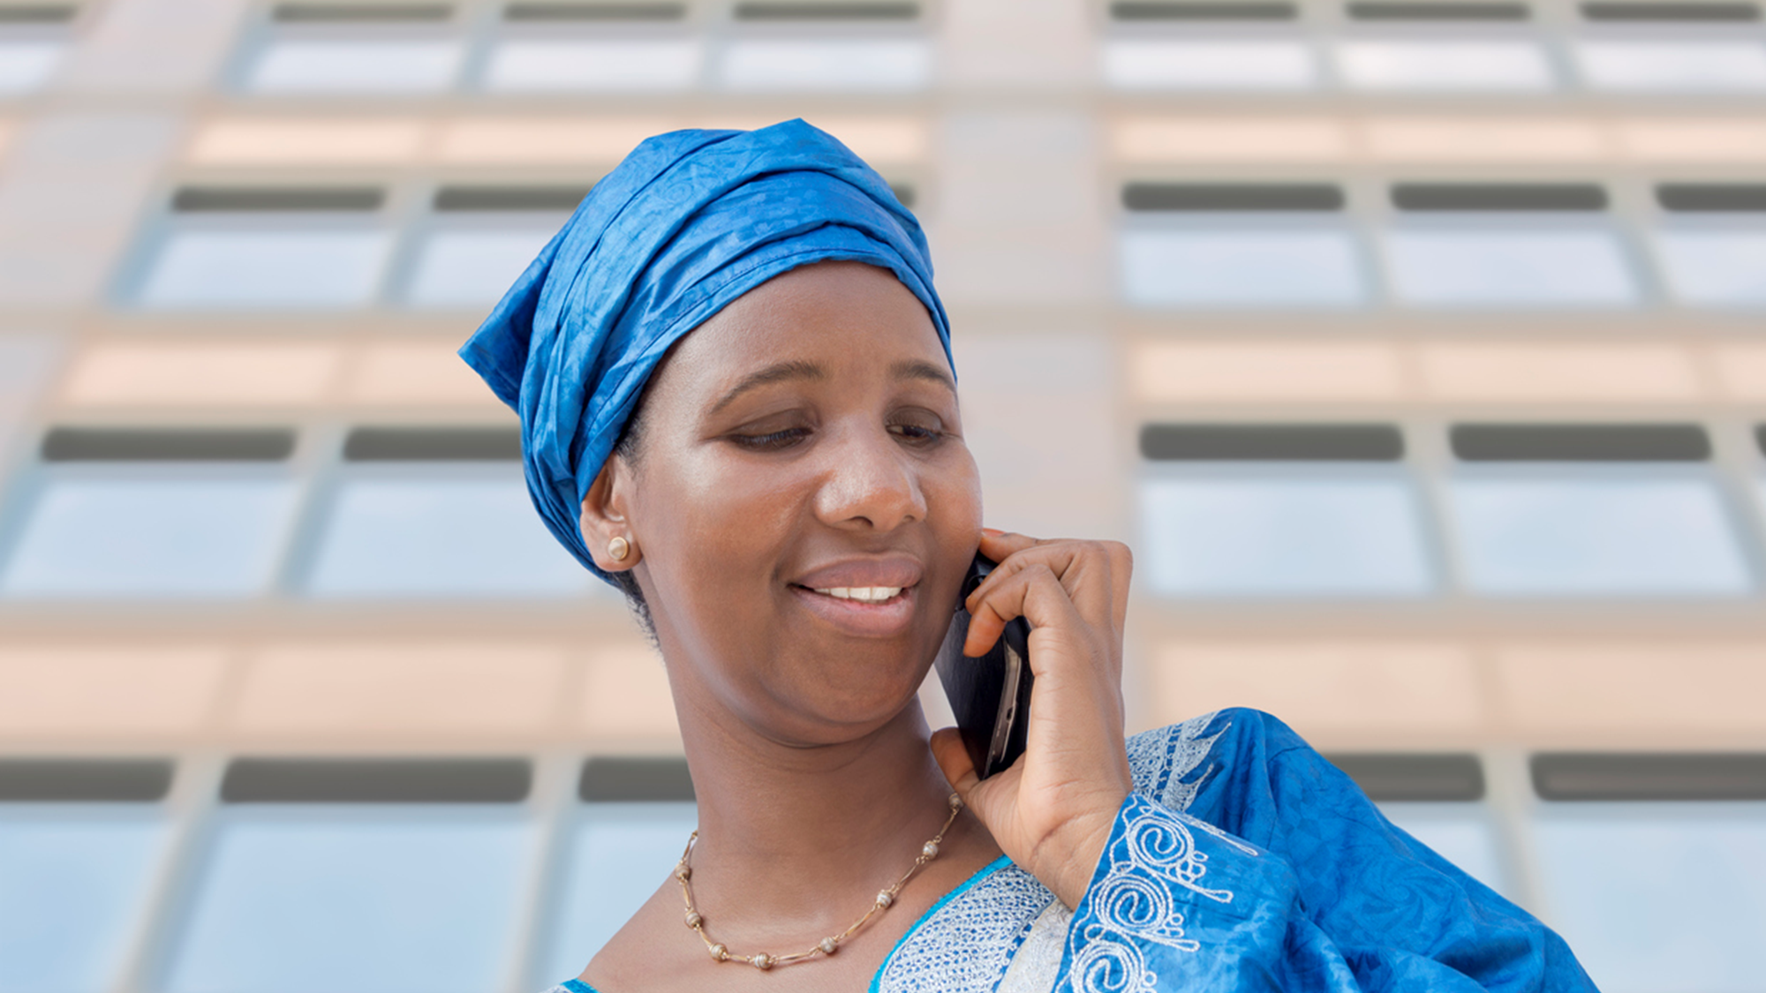
5
Understanding how the market engages with the world?

Slide 52
What are our markets media usage habits? This is a relatively connected market with communication and social dominating online activity.
Consumers Establish target connectivity
They’re online at least once a day | 1.16
Connections Identify major reach platforms
No. of online activities they’ll do daily: | 4.05
No. of online activities they’ll do per week: | 6.45
Content Determine content platforms & needs
Percentage who use social every day: | 59
Average number of platforms they use: | 2.38
Internet Access %:
Most popular online activities %:
Most favored social networks %:
n= 1500
n= 1500
n= 978
n= 1124

Slide 53
How do I reach the market?
Weekly activity is dominated by both online and offline formats with instant messaging, social media, traditional TV and radio presenting the best reach opportunity.
Weekly offline activity usage %
Weekly online activity usage %
n= 1199
n= 1500

Slide 54


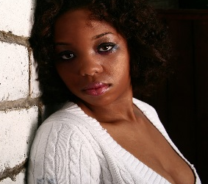
What are the key channels to target across consumer segments? Liberated Survivalists and Gender prisoners are most active online.
The Good
Girl
Conservative Survivalist
Liberated Survivalist
Gender
Prisoner
Protection
Savvy
Responsible
Achiever
Weekly online/ offline activity usage %
n= 1500
n= 317
n= 283
n= 307
n= 136
n= 191
n= 266
Significantly higher/lower than total

Slide 55
What are the dominant social networking platforms?
WhatsApp and Facebook stand out as key platforms to target these consumers
Weekly social usage in South Africa %
MESSAGING
SOCIAL
n= 1124

Slide 56
What is the influence of social media on the market?
68%
62%
61%
51%
47%
46%
Spend most of their online time on social media
Think they cannot live without social media
See social media as their main source of news and entertainment
Enjoy expressing their views through social networks and blog forums
Believe social media information more than other sources
Prefer to receive product information from brands or retailers
The implication for brands is that in a space as personal and curated as social media, customer needs must come first. To rebuild trust in content, marketers must go back to basics and get them right. This means adapting your strategy for each medium, embracing a moments based approach, and having two way conversations that benefit your customers.
n= 1029

Slide 57
Which consumer groups are highly influenced by social media?
Overall, social media is an important information and networking tool across consumer groups. Gender Prisoners are the most receptive to social media influences, while Liberated Survivalists and Responsible Moms are somewhat less engaged.
The Good
Girl
Conservative Survivalist
Liberated Survivalist
Gender
Prisoner
Responsible
Mom
Total market
Protection
Savvy
TOTAL
Spends a lot of time online on social media | 68 | 70 | 70 | 61 | 64 | 72 | 71
Can’t live without social media | 62 | 63 | 66 | 52 | 65 | 67 | 62
Social media is the main source of news & entertainment | 61 | 63 | 70 | 54 | 74 | 67 | 54
Enjoy expressing views online, in social networks, blogs, forums | 51 | 49 | 55 | 53 | 63 | 60 | 42
Trusts what people say on social media sites | 47 | 37 | 44 | 51 | 71 | 55 | 43
Prefer to seek advice from social media | 46 | 31 | 43 | 60 | 66 | 54 | 39
Significantly higher/ lower than total market

Slide 58
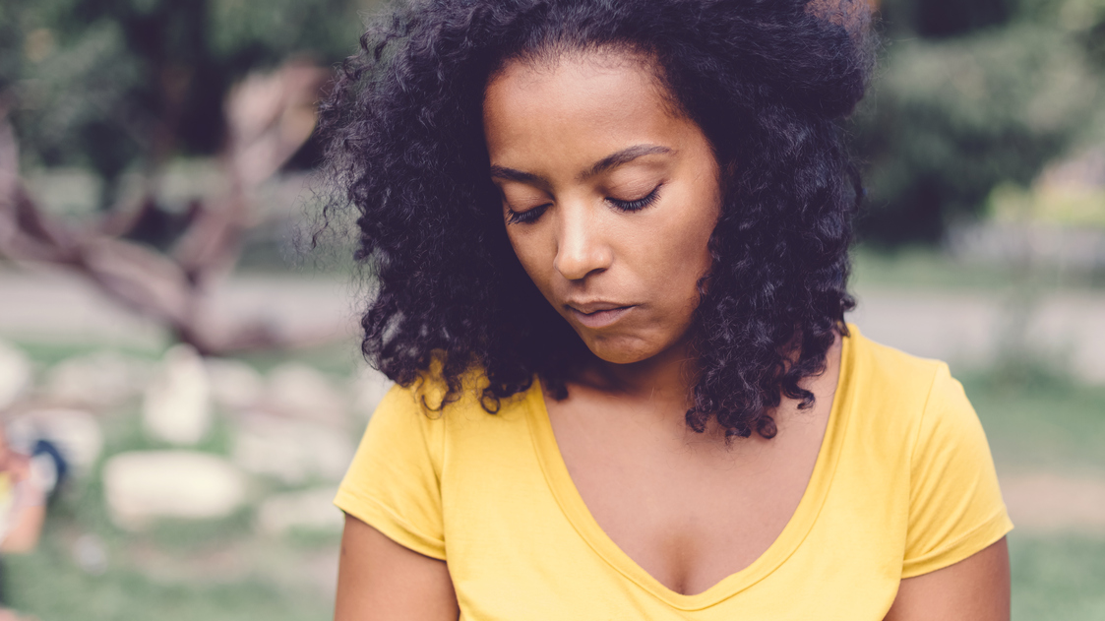
6
Understanding how the market makes product purchase decisions

Slide 59
How does the market make product purchase decisions?
Who makes the decision about which product to buy for own personal use? (%)
Who assists in the decision making process? (%)
Who pays for the purchases? (%)
n= 1500
n= 333
n= 1500

Slide 60
Which retail channels dominate purchasing of personal care products?
Grocery is the most accessible and affordable channel for this market. There is some cross pollination into Speciality/ Chemist for their ‘best deals’, ‘best brands’ and ‘easy layout’.
Retailer usage (last time)
Main reason for retailer selection
GROCERY
78%
SPECIALITY/ CHEMIST
15%
n=1155
CONVENIENCE
6%
CLINIC
1%
n=237
Significantly higher/lower than total

Slide 61
How do the consumer groups make purchase decisions?
 | Total | The Good Girl | Liberated Survivalists | Conservative Survivalists | Gender Prisoners | Protection Savvy | Responsible mom
% responsible for own purchase decisions | 77 | 57 | 78 | 76 | 89 | 87 | 88
% who have assistance with purchase decision making | 23 | 43 | 22 | 24 | 11 | 13 | 12
% assisted by mother | 83 | 82 | 84 | 84 | 81 | 75 | 90
% who pay for own purchases | 73 | 51 | 79 | 66 | 88 | 89 | 83
Significantly higher/ lower than total market

Slide 62
Key principles for a connected view of the shopper journey
01
02
03
04
Shopper marketing must sit within the context of a fully integrated marketing plan
Most decisions are made pre-purchase. Building strong brand equity must be the starting point for any shopper journey
When deciding where to invest, focus on the elements of the shopper journey which drive behaviour
Touchpoint evaluation must go beyond ‘reach’ to measure the true impact on purchase

Slide 63
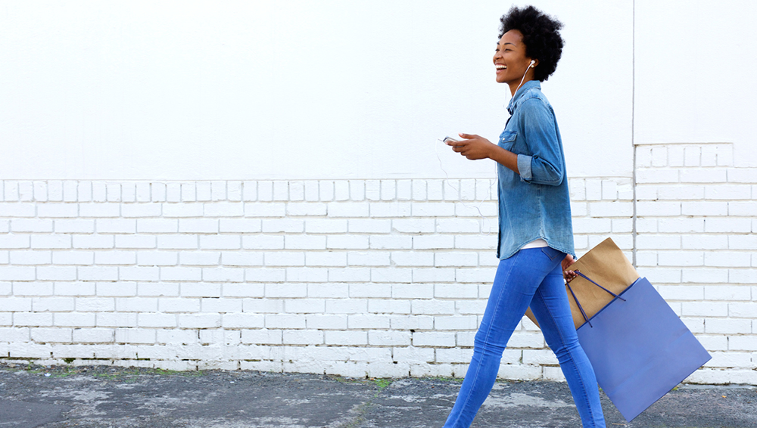
Shopper marketing must sit within the context of a fully integrated marketing plan

Slide 64
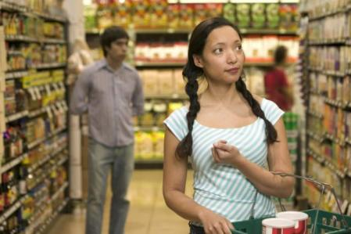
The point at which the brand decision is made is when to influence the shopper
Shoppers arrive at shelf with different tasks to do – success depends on making the distinction between them
Decided
…know what product they will buy
Decision Point Pre-store:
SEARCH

Slide 65
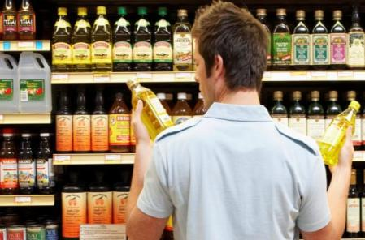
The point at which the brand decision is made is when to influence the shopper
Shoppers arrive at shelf with different tasks to do – success depends on making the distinction between them
Decided
Open
…know what product they will buy
…make some kind of decision at shelf
Decision Point Pre-store:
SEARCH
Decision Point In-Store:
SELECT

Slide 66
Majority of shoppers have a specific brand in their mind before entering the store and hence influencing shoppers is not just a store issue. Brand marketing cannot be separate from shopper marketing
Decided on brand pre-store and bought it %
Global market norms
Young, low income women in SA

Slide 67
The marketing task is to influence conversion along the complete shopper journey
And since shoppers are ‘connected’ in digital terms, the context is omnichannel, including eCommerce
Previous brand experience and communication
Brand equity
Brand
In-store
Brand
purchase

Slide 68




Integrated marketing plans are tricky
Ensure a common language and focus on customers across all silo’s
Customer service / satisfaction
Digital and social media
Trade marketing
Brand marketing
Source: Kantar TNS Connect study: Automotive

Slide 69
Five key tips for marketing through the customer journey
1
2
3
4
5
Consistency is key
Messaging when it matters
Match the channel to the need
Find the right mix
Remember to seal the deal

Slide 70
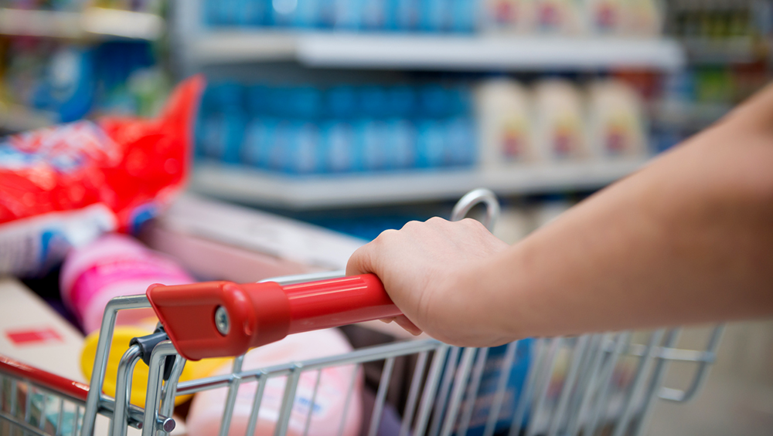
When deciding where to invest, focus on the elements of the shopper journey which drive behaviour

Slide 71
The ‘journey mindset’ impacts shopper behaviour pre-store presenting different opportunities and challenges to influence. Sanitary ware is characterised by a higher level of pressured shopper mindsets, whilst deodorant is more routine. Exploration does not strongly feature across both categories which is where brands have the greatest potential for influence.
79%
Run out of product
Routine
I was buying category products as usual / regular shop of this category
Pressured
I had an immediate requirement and needed to buy something from that category
Exploration
I wanted to explore products available which would best meet my needs
Why did you shop for the product the last time?

Slide 72
Journey mindsets across consumer groups
 | Total | The Good Girl | Conservative Survivalists | Liberated Survivalists | Gender Prisoners | Protection Savvy | Responsible mom
Routine
Pressured
Exploration
Why did you shop for the product the last time?
Significantly higher/ lower than total market

Slide 73
On an exploration journey, shoppers are exploring which products would best meet their needs. For sanitary protection, merchandising plays a key role influencing purchase decisions. Promotional activity is a key trigger for shopping deodorant.
Triggers for Exploration Mindset

Slide 74
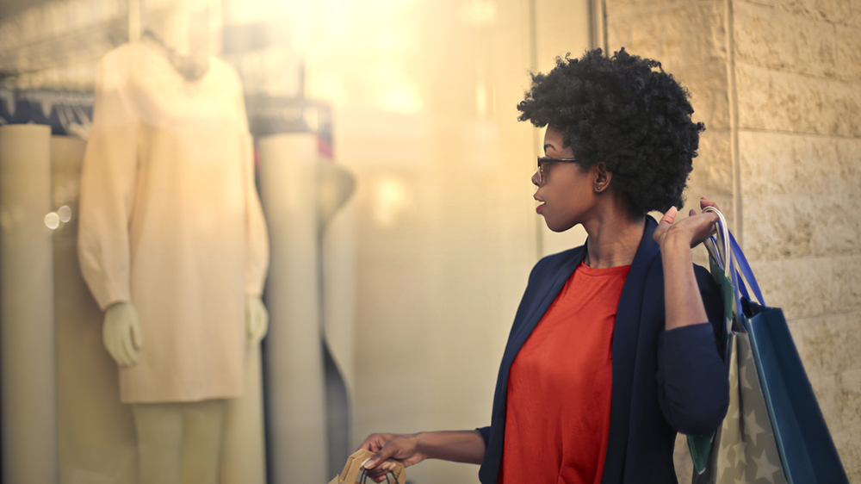
Touchpoint evaluation must go beyond ‘reach’ to measure the true impact on purchase

Slide 75
Which touchpoints are driving purchase decisions?
Shoppers are more likely to come to the store pre-armed with brand TV ads and recommendations which is also the markets preferred means of finding product information. Most engagement in-store is taking place at the shelf with the price label, packaging and POS material ultimately influencing their purchase decision.
n= 1500

Slide 76
What are the most impactful touchpoints across the path to purchase for deodorant? The market engages with the two categories differently. A more tangible experience through an event is most impactful for deodorant shoppers whilst the most impact for sanitary is generated through personal engagements online or face to face.
Aware
Browse and research
Decide & Buy
Touchpoint Impact
*Ranked on level of association*
 | Deodorant
 | Sanitary Protection
Traditional Advertising
Digital
Recommendation
POS
Promotion

Slide 77
Branding/ product characteristics

Slide 78
Which brand/product characteristics are key? Brand familiarity, trust and quality reassurance are key drivers for most consumers in this category
Most important characteristics
The Good
Girl
Conservative Survivalist
Liberated Survivalist
Gender
Prisoner
Protection
Savvy
Responsible
Mom
Brand familiarity and trustworthiness
Quality
Comfort (sanitary)
Smell (deodorant)
Easy to use
Price
More concerned about quality, fragrance (deodorant) and comfort (sanitary) |  | Less concerned about brand familiarity | Less concerned about brand familiarity |  | Brand and familiarity quality are very important, as well as fragrance (deodorant)

Slide 79
What emotional connection are consumer groups seeking?
Confident femininity is an important thread among all consumer groups to leverage in communication
The Good
Girl
Conservative Survivalist
Liberated Survivalist
Gender
Prisoner
Protection
Savvy
Responsible
Achiever
TOTAL
Inward reinforcement
Intrinsic benefits

Slide 80
Which of these have the biggest potential to influence brand choice? Medical practitioners would have the biggest impact in driving growth in this category
The Good
Girl
Conservative Survivalist
Liberated Survivalist
Gender
Prisoner
Protection
Savvy
Responsible
Mom

Slide 81
What product categories does the market desire?
The Good
Girl
Conservative Survivalist
Liberated Survivalist
Gender
Prisoner
Protection
Savvy
Responsible
Mom
Total market
TOTAL
n= 1500
n= 317
n= 283
n= 307
n= 136
n= 191
n= 266
Significantly higher/lower than total

